Slide 1

Felix – Canvas Support Chatbot (RAG-based)
AI chatbot for Yeshiva University students
By
Dheeraj Singh Shankar
Shashank Shekhar
Chaitanya Devarshi

Slide 2

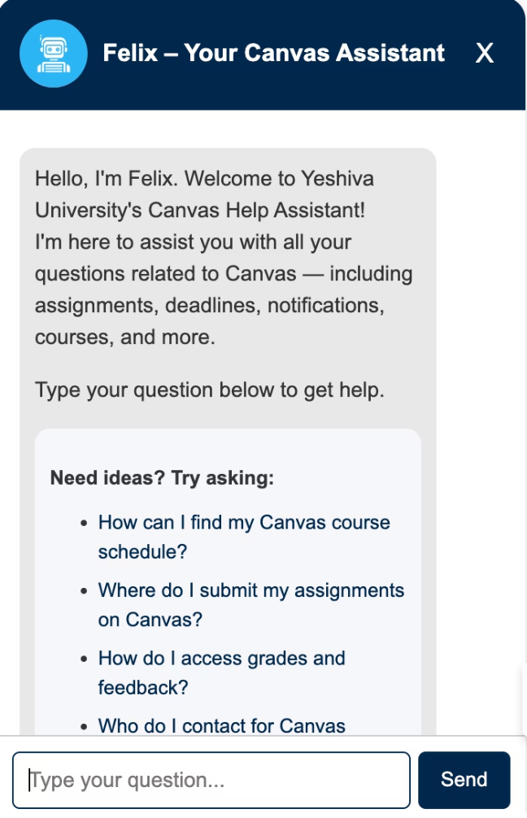
Meet Felix
AI-Powered Support
Multi-Tech Approach
Helps students navigate Canvas and academic questions
Combines rule-based, semantic, and generative AI
24/7 Availability
Supports assignments, schedules, grades, and career tools

Slide 3

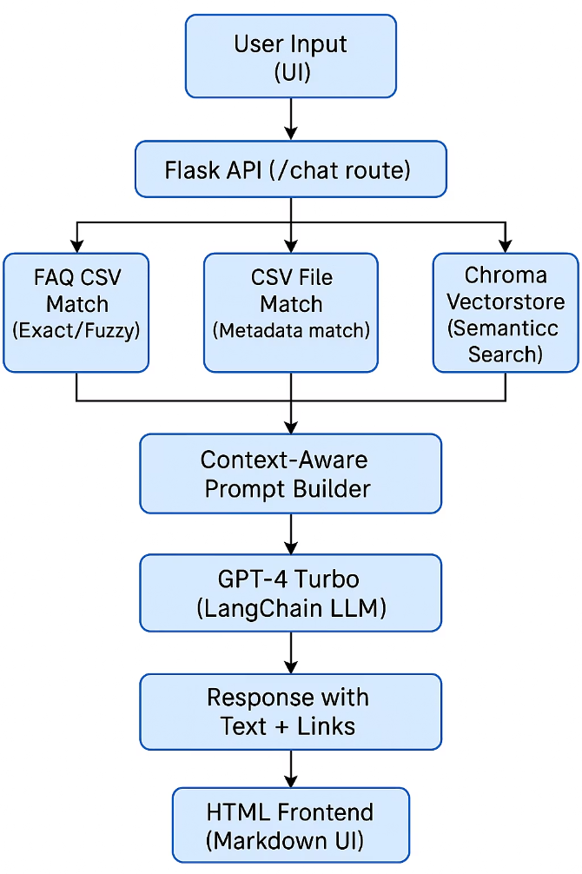
Chatbot Architecture

Slide 4

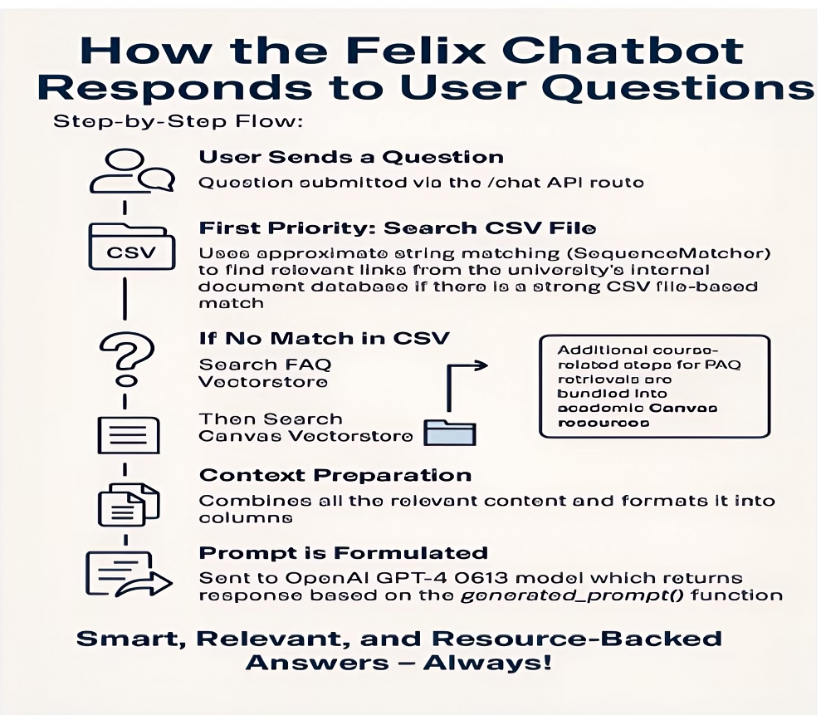
Felix Chatbot's Response Workflow
The process starts when a user submits a question. The system first searches a CSV file using string matching, then consults FAQs and the Vectorstore as needed. After preparing relevant context, a prompt is sent to OpenAI GPT-4, which generates intelligent and pertinent responses. The flowchart visually represents each step with clear, descriptive icons.

Slide 5

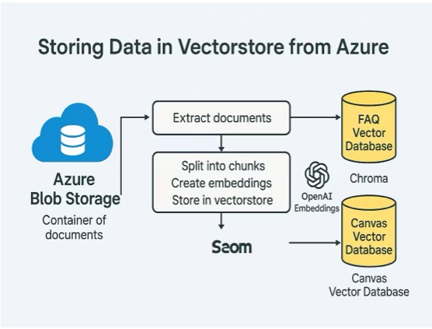
Azure Connection Flow
The flowchart with interconnected components highlights the relationships and data flow between various modules using labeled boxes and arrows. The hierarchical structure visually explains how different software elements interact within the system.

Slide 6





Development Challenges
Text Chunking
Prompt Fine-tuning
Canvas Integration
Balancing chunk size for context and token limits
Aligning responses with university tone and scope
Handling API limits and dynamic content parsing
Data Privacy
Azure Deployment
Ensuring approved, non-sensitive content only
Cost-effective, secure architecture under resource limits

Slide 7





Future Enhancements
Voice Capabilities
Voice input/output for accessibility and hands-free use
Content Expansion
Include more university departments for broader support
Feedback Collection
Real-time ratings to improve chatbot responses
Widget Integration
Embed chatbot as side widget in Canvas LMS
Mobile App
Push notifications and chatbot in university app

Slide 8

Thank You
Questions and feedback are welcome

